Slide 1
2026年1月浙江首考 读后续写讲评

Slide 2
Table of Contents
Story Background Overview
Building Ideas for Continuation Writing
Language Enhancement Techniques
Sample Essay and Summary

Slide 3
Story Background Overview
全面理解原文，把握故事脉络与核心要素，为续写打下坚实基础。

Slide 4
阅读下面材料，根据其内容和所给段落开头语，使之构成一篇完整的短文。 On a sunny Saturday afternoon, I was driving my daughter to her weekly swimming lesson. As we came to a heavily traveled street, we saw an unusual procession approaching: a bony, wild-eyed cow followed by many cars, and boys on bicycles and on foot.
“That poor cow!” I said angrily. “Those ignorant city people are frightening her.”
At that time, my daughter, aged nine, believed that her papa was equal to any crisis. “What are you going to do?” she asked.
“See that piece of rope around her neck?” I said. “After I leave you at the swimming center, I’ll go back and catch her and hold her for her owner, who’s probably trying to find her.” Having milked cows as a boy and worked with beef cattle, I knew—so I thought—all about cows.

Slide 5
阅读下面材料，根据其内容和所给段落开头语，使之构成一篇完整的短文。 Later I learned that this particular cow had come from at least seven miles away and, on the way, had knocked down several people. She had passed a baseball field, breaking up the game and flattening the umpire (裁判) in passing. In brief, ruins lay behind her. The crowd was not following her with intent to harm her, but merely to see what she would do next.
I left my daughter at the swimming center, circled back and found the cow standing at the grassy edge of a side street, breathing heavily. The crowd surrounded her — at a respectful distance. I parked my car, pitying their ignorance, walked up to the cow in what the onlookers assumed to be a fearless manner.
She watched me narrowly as I approached, turning her head to view me with one big eye, then the other. At thirty feet from her I have a slight hesitation, at twenty a serious doubt. At ten feet I stopped and realized the truth. Here was a cow foreign to my experience. Driven completely crazy, she was ready to charge anything that moved.
Paragraph 1: As I turned to leave, two police officers pulled up in a patrol car.
Paragraph 2: We tied the rope to a tree and discussed what to do with the cow

Slide 6
Six Elements of a Story
明确故事框架，确保续写逻辑合理。
时间 (When)
1
A Saturday morning.
地点 (Where)
2
on a city street
人物 (Who)
3
起因 (What)
the father, his daughter Emma, a frightened cow, as well as a policeman and onlookers.
The father and daughter encounter a frightened cow that is lost and surrounded by a crowd while passing by.
4
经过 (Why)
5
To fulfill his promise to his daughter to "do the right thing," the father decides to help the cow.
结果 (How)
6
The story is not yet finished. It requires us to write a continuation that shows how the problem is resolved and concludes with an emotional resolution.

Slide 7
Analysis of Foreshadowing in the Original Text
Foreshadowing 1: My Experience
"I spent my childhood on a farm… worked at a beef processing plant." 这表明我在应对牛这方面有经验，为下文我主动提供应对措施并成功解决问题埋下伏笔
Digging into the text's details to predict the direction of plot development.
Foreshadowing 2: My Daughter's Trust
"Emma believed I would do the right thing."Emma had started seeing me as a true hero who could solve any problem fairly 这是推动我行动的核心动力，也创造了一种道德压力，使我的选择至关重要。
Foreshadowing 3: The Cow's Hostility
"The cow lowered its head and let out a threatening sound." 直接点明情况危急，单靠我一人难以解决，暗示需要外部帮助或更专业的处理方法。
Foreshadowing 4: The Cow's Final Home
"I would calm it down and help it find its way home." 暗示最后的结局可能是把牛送到了农场

Slide 8
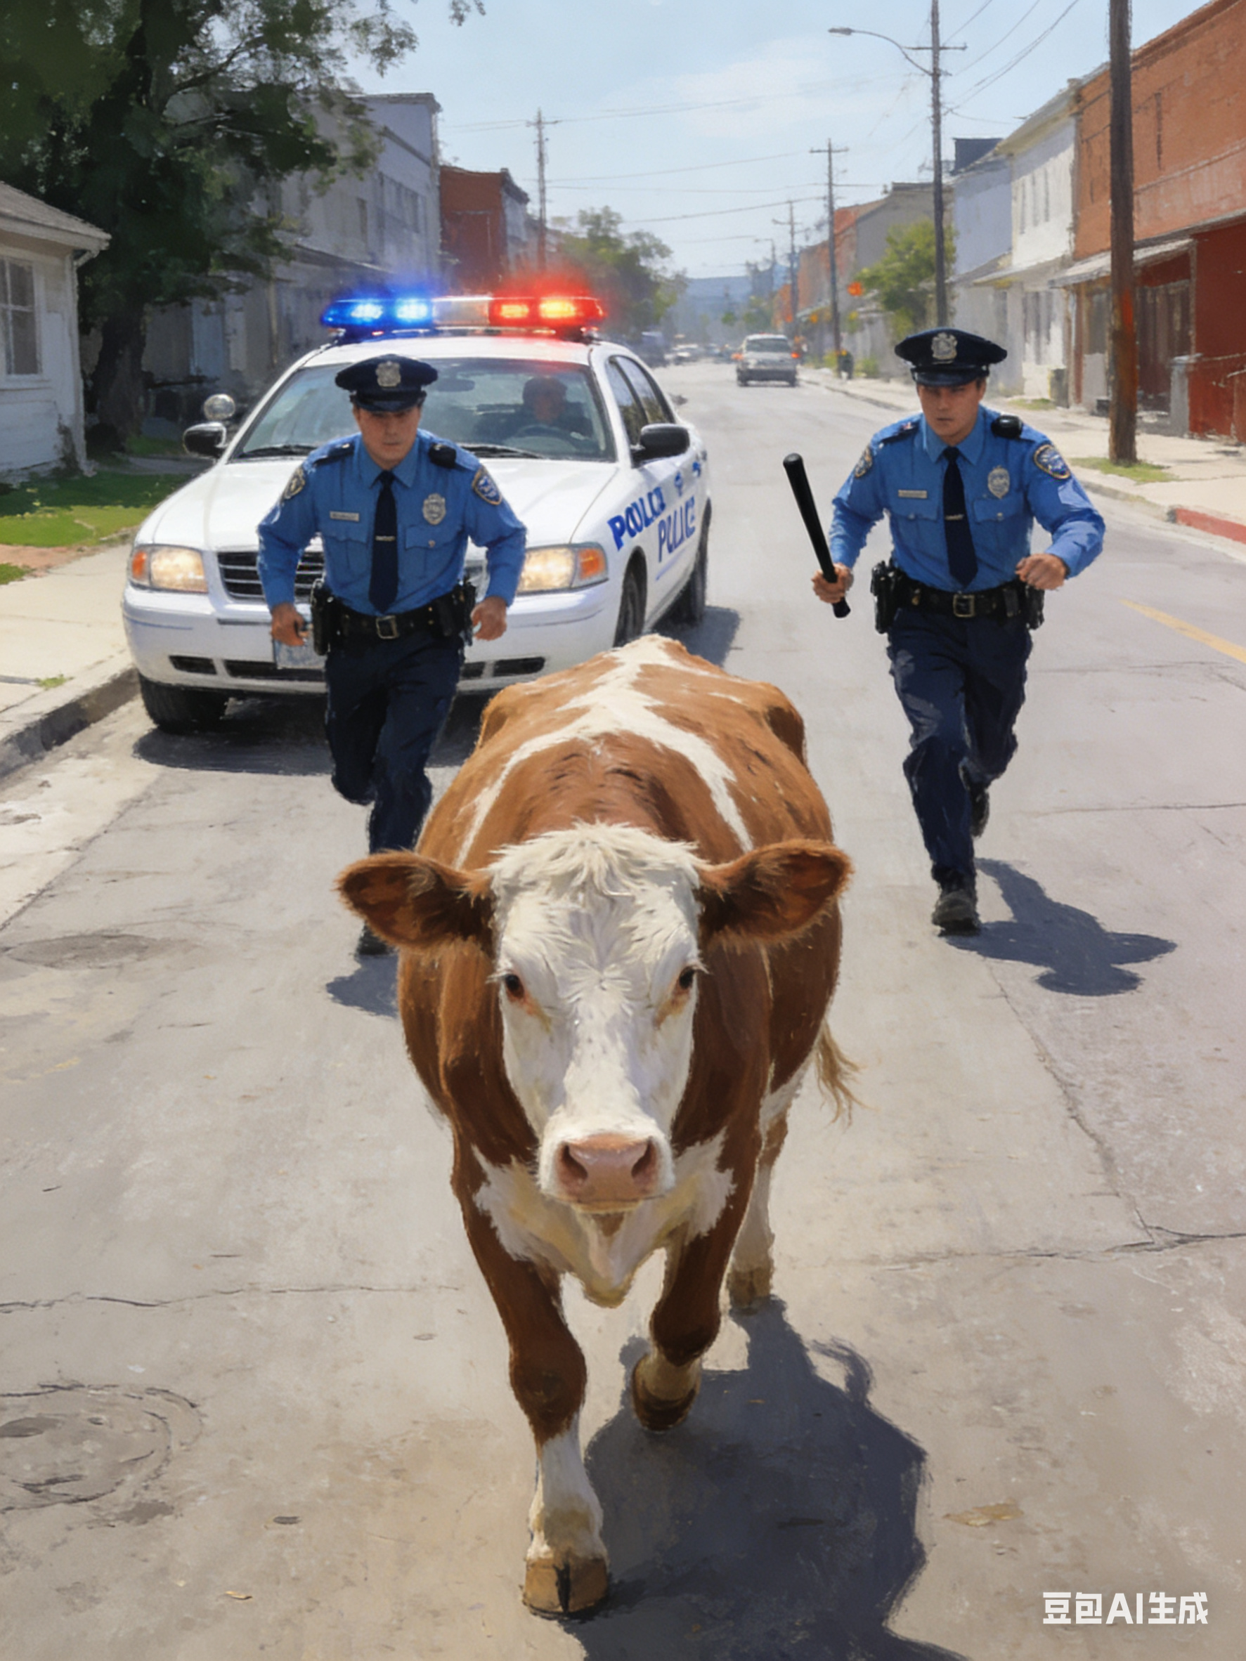
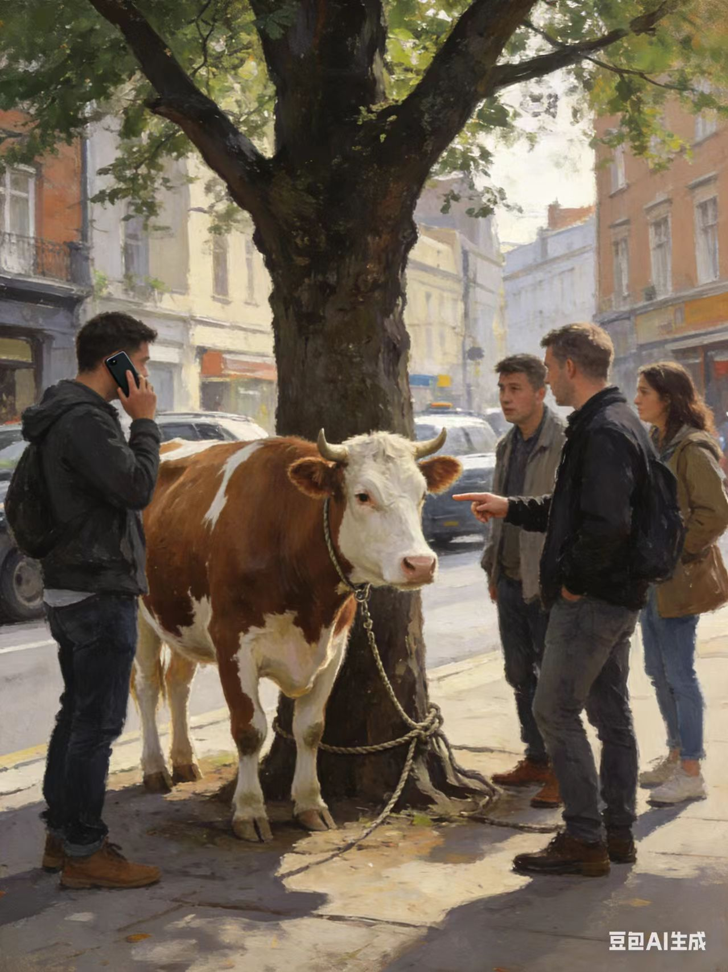
Building Ideas for Continuation Writing
深度解析段首句，设计关键情节与冲突，构建完整的故事链条。

Slide 9
Interpretation of the First Paragraph's Opening Sentence
Para 1： As I turned to leave, two police officers pulled up in a patrol car.
1
1. The Officers' Rough Intervention
Describe the officers using forceful methods (like yanking the rope and shouting orders), which only made the cow more agitated and caused the situation to be out of control. This created a new conflict by contrasting sharply with my preferred gentle approach.
2
2. My Psychological Turning Point
Witnessing the chaos, my inner fear (e.g., My heart pounded) clashed fiercely with my sense of responsibility (e.g., Emma's trusting eyes flashed in my mind). Ultimately, my sense of duty triumphed over my fear, and I decided to step forward and help.
3
3. My Successful Intervention and Its Outcome
I approached the cow slowly from the side, speaking to it in a low, gentle voice, and I offered it some hay to build trust. The cow lowered its guard and lost its hostility. Seizing the opportunity while it was eating, we secured it to a tree.

Slide 10
Interpretation of the Second Paragraph's Opening Sentence
Para 2： We tied the rope to a tree and discussed what to do with the cow
1
1. The Dilemma in the Discussion 讨论中的困境
The crowd was full of noisy, conflicting opinions, with suggestions like "Send it to the pound!" or "Just send it to the slaughterhouse." These proposals were either inhumane or impractical, highlighting the complexity of the problem.
2
2. My Promise and Action 我的承诺与行动
Suddenly, I remembered my promise to Emma: "help it find its way home." This became my guiding principle. Leveraging my farm knowledge and connections , I proposed the most reasonable solution.
3
3. Emotional Closure 情感闭环
When I picked Emma up from her class and told her what had happened, her reaction—such as saying "You kept your word"—filled me with pride. It also deepened her understanding of my "hero" image, creating a satisfying emotional arc that echoed the story's beginning.

Slide 11

Key Scene Design
通过具体描写，使故事生动、人物形象丰满。
Scene 1
Scene 2
Scene 3
The Officers' Missteps
My Inner Struggle
My Effective Intervention
"Get back!" one officer shouted, yanking the rope harshly. The cow snorted violently, eyes rolling in panic. 通过动作和神态描写，展现警察方式的简单粗暴以及牛的极度恐惧。
A jolt of guilt shot through me. Emma’s trusting eyes flashed in my mind. 使用抽象情感具体化（guilt shot through me）和闪回（her eyes flashed）的技巧，深化内心描写。
I crouched low, palms open and empty, speaking in a soft, singsong voice. Drawing on childhood memories, I stepped forward slowly... 通过一系列的动作细节，如蹲下、张开手掌、用柔和的声音，塑造我专业且富有同情心的形象。

Slide 12
Key Scene Design
Scene 4
Scene 5
Scene 6
Group Discussion & Escalating Conflict
Implementation of the Solution
Achieving Emotional Closure
Her eyes lit up like stars. “You’re my hero, Dad!” She threw her arms around me, her pride warmer than the afternoon sun.
Suggestions flew from every direction. The crowd buzzed with conflicting ideas, none of them practical.
Pulling out my phone, I dialed a farmer I knew. Within half an hour, his trailer arrived.

Slide 13
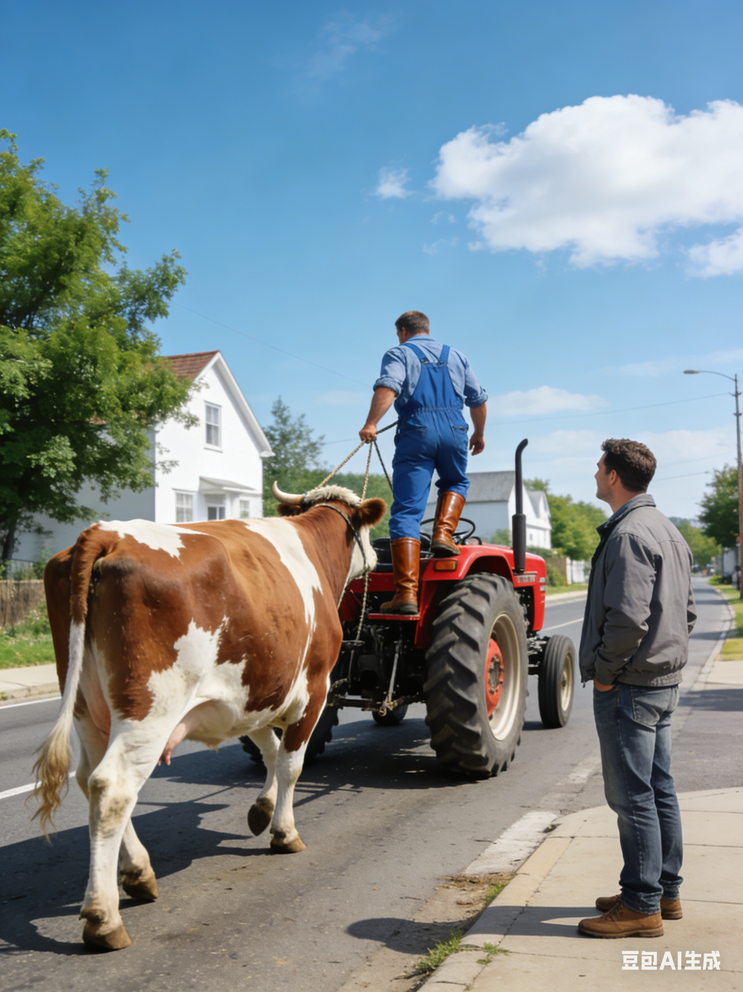

Language Upgrading Techniques
积累高级词汇与句型，提升语言表现力，让你的续写脱颖而出。

Slide 14
Scene 1 警察到场，奶牛惊恐
1.他们迅速行动，试图驱散人群，但他们威严的声音反而加剧了奶牛的恐惧。
翻译：They quickly moved to disperse the crowd, but their authoritative voices only heightened the cow's terror.
语言亮点："disperse the crowd" 是一个正式的动词短语，常用于描述官方或有组织的行动。"authoritative" 和 "heightened" 都是高级词汇，分别替换了更基础的 "loud" 和 "increased"，提升了文本的格调。
2.它猛地直立起来，惊恐地用蹄子踢打着空气。
翻译：It reared up, its hooves striking the air with panicked force.
语言亮点："reared up" 是描述动物（尤其是马或牛）直立的专业动作。"hooves striking the air" 使用了独立主格结构，在不增加新句子的情况下，生动地补充了动作的细节，是一个非常高级的语法结构。

Slide 15
Scene 2 我的内心纠结+主动请缨
1.看着它因恐惧而转动的眼睛，我想起了艾玛轻柔的提问，以及她声音里那份笃定的信任。
翻译：Watching its eyes roll with fear, I thought of Emma's soft question and the quiet faith in her voice.
语言亮点："Watching..." 是现在分词作状语，表示伴随动作，使句子结构更紧凑。"quiet faith" 是一个精妙的搭配，用 "quiet" 来形容 "faith"，将抽象的信任具体化，展现了女儿信念的纯粹和坚定。
2.我鼓起全部的勇气，走上前去。"警官们，我和牲畜打交道。让我试试。" 我坚定地说。。
翻译：Summoning every ounce of courage, I stepped forward. "Officers, I worked with cattle. Let me try," I said firmly.
语言亮点："Summoning every ounce of courage" 是一个非常有力量的表达，"summon" 和 "ounce" 的搭配，比 "taking a deep breath" 更能体现内心挣扎和鼓起勇气的过程。"firmly" 这个副词用得很到位，精准地传达了说话者此时从恐惧转变为坚定的态度。

Slide 16
Scene 3 我的具体做法
1.我从一个侧面向奶牛靠近，用我之前用过无数次的低沉而有节奏的语调对它说话。。
翻译：I approached the cow at an angle, speaking in the low, rhythmic tone I'd used a hundred times before.
语言亮点："at an angle" 是一个具体的动作描述，体现了作者的专业知识。"speaking..." 是现在分词作伴随状语，使句子结构更流畅。"rhythmic tone" 则通过声音的细节，展现了安抚的专业性。
2.我把手伸进包里，掏出了一把我为应急准备的甜饲料
翻译：Reaching into my bag, I pulled out a handful of sweet feed I kept for emergencies.
语言亮点："Reaching into..." 同样是现在分词作状语，保持了动作的连贯性。"kept for emergencies" 是过去分词作后置定语，简洁地解释了饲料的用途。

Slide 17
Scene 4 众说纷纭，讨论如何处置奶牛
1.有人建议打电话给动物收容所，还有人开玩笑说要在社区里搞个烧烤派对。
翻译：Some suggested calling the pound, while others joked about a neighborhood barbecue.
语言亮点："while" 在这里表示对比，连接了两种截然不同的态度。”some...others...”：“有些人...其他人..."。pound" 是一个特定的词汇，指的是 "走失动物待领所"，比更宽泛的 "shelter" 更精确。
2.我想起了对艾玛的承诺 —— 要帮这头奶牛找到回家的路。
翻译：I remembered the promise I'd made to Emma—to help the creature find its way home.
语言亮点："creature" 这个词比简单的 "animal" 更有感情色彩，暗示了作者对奶牛生命的尊重。破折号在这里用来解释说明，让句子的结构更加丰富。

Slide 18
Scene 5 联系农场主，送奶牛回农场
1.一名警察打了电话，不到一个小时，一位饱经风霜的农场主就赶到了，如释重负的表情瞬间写在了脸上。
翻译：An officer made the call, and within the hour, a weathered farmer arrived, relief washing over his face
语言亮点："weathered" 是一个非常传神的形容词，它不仅指皮肤因日晒雨淋而粗糙，更暗示了农场主的人生阅历。"relief washing over his face" 是一个非常形象的比喻，将抽象的情绪转化为具体的视觉画面。
2.当他们开车离开时，黛西低沉的哞叫声听起来几乎像是在道谢。
翻译：As they drove away, Daisy's low moo sounded almost like a thank you.
语言亮点："sounded almost like a thank you" 是一种拟人化的表达，赋予了动物情感，为故事增添了温暖的色彩。

Slide 19
Scene 6 女儿得知事情原委后的反应
1.当我去游泳馆接艾玛时，我把这件事的经过告诉了她。她的眼睛里闪烁着纯粹的敬佩之光。
翻译：When I picked Emma up from swimming, I told her the story.Her eyes lit up with pure admiration.
语言亮点："lit up" 是一个非常生动的短语，形象地描绘了女儿眼睛发亮的样子。"pure admiration" 则强调了这份情感的真挚和不加掩饰。
2."我就知道你会找到正确的方法，爸爸，" 她说。那一刻，我感受到了一种因不辜负她的信任而产生的、宁静的自豪感。
翻译："I knew you'd find the right way, Dad," she said, and in that moment, I felt the quiet pride of living up to her faith.
语言亮点："living up to her faith" 是一个核心的主题句，将故事的情感推向了高潮。"quiet pride" 是一种深刻而内敛的情感表达，比简单的 "felt proud" 更有深度，也更能打动人心。

Slide 20
Sample Essay and Summary

Slide 21
第一段续写示范
Just as I was about to turn and run, two police officers arrived on the scene. They jumped out instantly, set up a cordon and evacuated the crowd. Waving batons and shouting harshly, they tried to drive the cow away, but the rough tactics only made it more terrified and aggressive. A fierce internal struggle gripped me—I recalled Emma’s admiring eyes, my boast and the animal-taming skills learned on the farm. Summoning up my courage, I stepped forward and offered to help. I shed my bright jacket, approached sideways and murmured softly. Then I fetched fresh hay from my car, held it out and waited. After minutes of patient coaxing, the cow relaxed and started munching. Signaling the police, we secured it to a tree with a rope.
综合运用所学技巧，构建情节丰富、描写生动的第一段。

Slide 22
第二段续写示范
After we managed to secure the cow to a tree, we began to discuss what to do with it. Bystanders argued fiercely: some suggested the animal shelter, others the slaughterhouse, while the police proposed temporary foster care. Remembering my promise to Emma, I advised contacting local farms. Luckily, a farmer soon arrived, recognizing the cow as his. We helped load it onto his trailer and sent it back to the farm. Later, when I picked up Emma and told her the story, her eyes sparkled with pure admiration and pride. At that moment, I realized that being a hero isn’t about performing grand deeds, but about keeping a simple promise and showing kindness to a helpless creature in need. It is these small, warm acts that weave the most beautiful threads in the fabric of our lives.
完成故事结局，通过情感升华，点明文章主旨。

Slide 23
Summary & Q&A
Let's review the key points of this lesson and answer any questions.
Review Key Points
01
The six elements of a story, foreshadowing, key scene descriptions, and advanced vocabulary and sentence patterns.
Interactive Session
02
Now, please share any problems or confusion you've encountered in your writing.

Slide 24
Student Writing Practice
Apply what you've learned and put it into practice to complete your own story continuation.
1. Practice Task
4. Evaluation Criteria
3. Word Count
Requirement
2. Writing Tips
Please complete the story continuation based on the original text and the two given opening sentences.
Ensure consistency with the original plot, character personalities, and language style.
Approximately 150 words.
1.Logical coherence
2.language expressiveness 3.emotional depth
4.thematic elevation.

Slide 25
Thank You!

